Slide 1
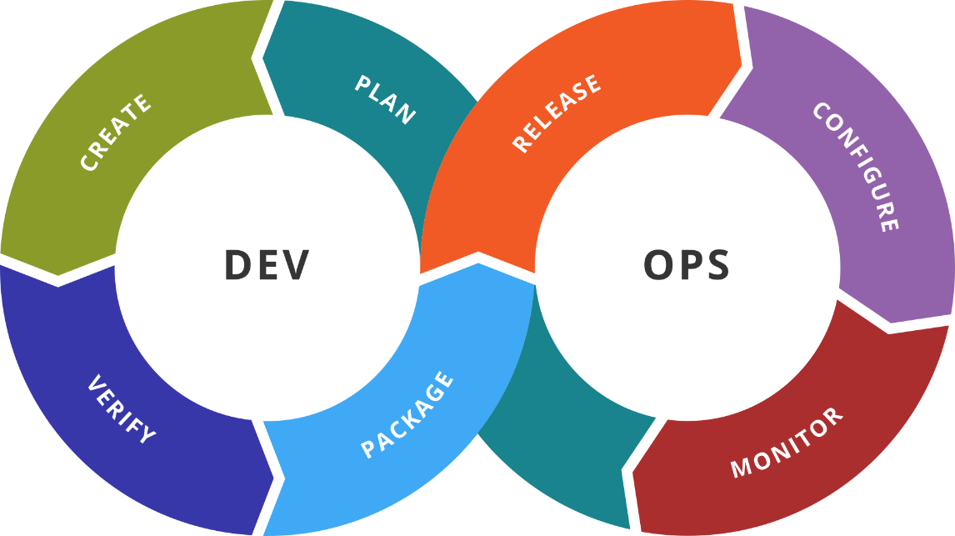
Advanced Docker
Advanced Techniques. Distributed Applications. Clusters
SoftUni Team
Technical Trainers
Software University
https://softuni.bg

Slide 2
You Have Questions?
sli.do
#DevOps-23
facebook.com
/groups/DevOpsContainerizationCICDMonitoringJanuary2023

Slide 3
Homework Progress
Solutions for M2
can be submitted
until 23:59 on 15.02.2023
Solutions for M3
can be submitted
until 23:59 on 22.02.2023

Slide 4

Previous Module (M2)
Quick Overview

Slide 5
What We Covered
Containerization
Introduction to Docker
Docker in Action
Create Our Own Images

Slide 6

Dev
Ops
This Module (M3)
Topics and Lab Infrastructure

Slide 7
Table of Contents
Advanced techniques
Networking
Volumes
Distributed Applications
Linking Methods
Docker Compose
Docker Clusters
Components and Principles
Docker Swarm

Slide 8
Lab Infrastructure
2-nd NETWORK: Internal Network (A.B.C.D/24)
Int
.100
.101
.102
.103
Docker Swarm
DOCKER
DOCKER #1
DOCKER #2
DOCKER #3
NAT
1-st NETWORK: NAT Adapter (with port forwarding for easier management)
VirtualBox / VMware / Hyper-V
vagrant
Windows / Linux / macOS

Slide 9
Dev
Ops
Communication
Networks: Overview and Usage

Slide 10
Docker Network
Uses pluggable drivers. There is a set of preinstalled drivers
bridge is the default driver. It allows containers connected to the same bridge to communicate while isolating them from the rest
host uses the host’s networking directly
overlay connects multiple Docker daemons together and enables swarm services to communicate with each other
ipvlan gives total control over both IPv4 and IPv6 addressing
macvlan allows for assigning specific MAC addresses to containers
none disables all networking for a container

Slide 11
Default Network
Docker Host (docker)
Start a container with no explicit network settings
We can expose a container port
Container (web)
eth0: 172.17.0.3
:80
docker container run -d --name web \
img-web
veth
docker container run -d --name web \
-p 8080:80 img-web
docker0
eth0: 192.168.99.100
:8080

Slide 12
Custom Network
Docker Host (docker)
Create a bridge network
Start container connected to specific network
Container (web)
docker network create -d bridge net1
eth0: 10.0.0.5
veth
docker container run -d --name web \
--net net1 img-web
docker0
net1
eth0: 192.168.99.100

Slide 13
Two Networks
Docker Host (docker)
Create a bridge network Start container connected to the default network
Start container connected to specific network
Connect container to another network
Container (web)
Container (db)
docker network create -d bridge mynet
eth0: 172.17.0.3
eth1: 10.0.0.4
eth0: 10.0.0.5
docker container run -d --name web \
img-web
veth
veth
veth
docker0
mynet
docker container run -d --name db \
--net mynet img-db
eth0: 192.168.99.100
docker network connect net1 web

Slide 14
network ls
Purpose
List networks
Syntax
Example
docker network ls [options]
# list IDs of all networks
docker network ls -q
# list all networks that satisfy the filter
docker network ls -f driver=bridge

Slide 15
network inspect
Purpose
Display detailed information on one or more networks
Syntax
Example
docker network inspect [options] network [network]
# show network details
docker network inspect dob-network

Slide 16
network connect
Purpose
Connect a container to a network
Syntax
Example
docker network connect [options] network container
# connect container to a network
docker network connect \
dob-bridge \
cont-001

Slide 17
network disconnect
Purpose
Disconnect a container from a network
Syntax
Example
docker network disconnect [options] network container
# disconnect container from a network
docker network disconnect -f \
dob-bridge \
cont-001

Slide 18
network create
Purpose
Create a network
Syntax
Example
docker network create [options] network
# create new bridge network
docker network create -d bridge \
--subnet 10.0.0.1/24 \
dob-bridge

Slide 19
network rm
Purpose
Remove one or more networks
Syntax
Example
docker network rm network [network]
# remove networks net-1 and net-2
docker network rm net-1 net-2

Slide 20
network prune
Purpose
Remove all unused networks
Syntax
Example
docker network prune [options]
# remove all unused networks without asking
docker network prune --force
# remove all network satisfying a filter
docker network prune --filter driver=bridge

Slide 21
Dev
Ops
Persistent Data
Volumes: Overview and Usage

Slide 22
Volume Overview
Allow for external data in containers
Two types
Data volumes
Data volume containers
Created upfront, during run or build phase (VOLUME command)
Data volumes can be shared
Data volumes persist
Data volumes are not deleted automatically

Slide 23
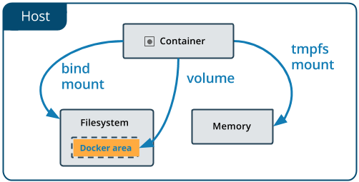
Volume Overview #2
Bind Mounts are dependent on the OS and file system structure
Volumes are managed by Docker
tmpfs mount is for non-persistent state data
--volume (-v) is simpler, and --mount is more explicit and verbose
https://docs.docker.com/storage/volumes/

Slide 24
volume ls
Purpose
List volumes
Syntax
Example
docker volume ls [options]
# list IDs of all volumes
docker volume ls -q
# list all volumes satisfying a filter
docker volume ls --filter driver=local

Slide 25
volume inspect
Purpose
Display detailed information on one or more volumes
Syntax
Example
docker volume inspect [options] volume [volume]
# show details about volume test-vol
docker volume inspect test-vol

Slide 26
volume create
Purpose
Create a volume
Syntax
Example
docker volume create [options] [volume]
# create local volume test-vol
docker volume create test-vol
# create local volume lv-1 with label
docker volume create lv-1 --label mode=dev

Slide 27
volume rm
Purpose
Remove one or more volumes
Syntax
Example
docker volume rm [options] volume [volume]
# remove volume test-vol
docker volume rm test-vol

Slide 28
volume prune
Purpose
Remove all unused volumes
Syntax
Example
docker volume prune [options]
# remove all unused volumes without asking
docker volume prune -f
# remove all volumes satisfying a filter
docker volume prune --filter driver=local

Slide 29
Dev
Ops
Practice: Networks & Volumes
Live Demonstration in Class

Slide 30
Dev
Ops
Distributed Applications
Overview and Implementation

Slide 31
Distributed Applications
Web application
User Interface
User Interface
Container
Business Logic
Business Logic
Containerized application
Container
Database Layer
Database Layer
Server
Container

Slide 32
Link Containers (Legacy) *
By name alias
Container
#1
Container
"c-db"
db
Container
"c-web"
Shared Network (docker0)
docker container run -d ... -p 8080:80 --link c-db:db ...
Linkage in the form name:alias
* Should be avoided as it is legacy and may be removed in future versions

Slide 33
Isolated Network
Work in an isolated environment
app-network
Container
#1
Container
db
Container
web
Shared Network (docker0)
docker container run -d ... -p 8080:80 --net app-network ...
Attached to the isolated network

Slide 34
Dev
Ops
Docker Compose

Slide 35
Docker Compose
Define and run multi-container Docker applications
Multiple isolated environments on a single host
Preserve volume data when containers are created
Only recreate containers that have changes
Supports variables
Use cases
Development environments
Automated testing
Single host deployments

Slide 36
Configuration
Version (up to 3.9)
(optional since v1.27.0)
version: "2.1"
services:
com-php:
build: ./web/
ports:
- 8080:80
volumes:
- "${PROJECT_ROOT}:/var/www/html:ro"
networks:
- com-network
networks:
com-network:
PROJECT_ROOT=/home/docker/app
DB_ROOT_PASSWORD=12345
.env
Services Definition
Networks Definition
docker-compose.yaml

Slide 37
docker compose build
Purpose
Build or rebuild services
Syntax
Example
… build [options] [--build-arg key=val...] [SERVICE...]
# rebuild all services
docker compose build
# rebuild particular service with no-cache
docker compose build --no-chache my-php

Slide 38
docker compose up
Purpose
Build, (re)create, start, and attach to containers for a service
Syntax
Example
… up [options] [--scale SERVICE=NUM...] [SERVICE...]
# start all containers and aggregate the output
docker compose up
# start all containers in a daemon mode
docker compose up -d

Slide 39
docker compose down
Purpose
Stop containers and remove everything created by up
Syntax
Example
docker compose down [options]
# remove everything including all images
docker compose down --rmi all
# remove declared named volumes and anonymous volumes
docker compose down --volumes

Slide 40
docker compose ps
Purpose
List containers
Syntax
Example
docker compose ps [options] [SERVICE...]
# list running containers
docker compose ps
# display ID for a particular container
docker compose ps -q com-php

Slide 41
docker compose logs
Purpose
View output from containers
Syntax
Example
docker compose logs [options] [SERVICE...]
# view logs for all containers
docker compose logs
# follow the log for com-php service
docker compose logs -f com-php

Slide 42
docker compose start
Purpose
Start existing containers
Syntax
Example
docker compose start [SERVICE...]
# start all containers
docker compose start
# start particular container / service
docker compose start com-php

Slide 43
docker compose stop
Purpose
Stop running containers without removing them
Syntax
Example
docker compose stop [options] [SERVICE...]
# stop all containers
docker compose stop
# stop particular container / service with timeout
docker compose stop -t 20 com-php

Slide 44
docker compose rm
Purpose
Remove stopped service containers
Syntax
Example
docker compose rm [options] [SERVICE...]
# remove all stopped containers
docker compose rm
# stop all containers and remove them without asking
docker compose rm -s -f

Slide 45
Dev
Ops
Practice: Docker Compose
Live Demonstration in Class

Slide 46
Dev
Ops
Docker Swarm
What is it? How it works?

Slide 47
What is it?
Docker engines joined in a cluster
Commands are executed by the swarm manager
There could be more than one manager, but only one is Leader
Nodes that are not managers are called workers
Both managers and workers are running containers
There are different strategies to run containers
Nodes can be physical or virtual

Slide 48
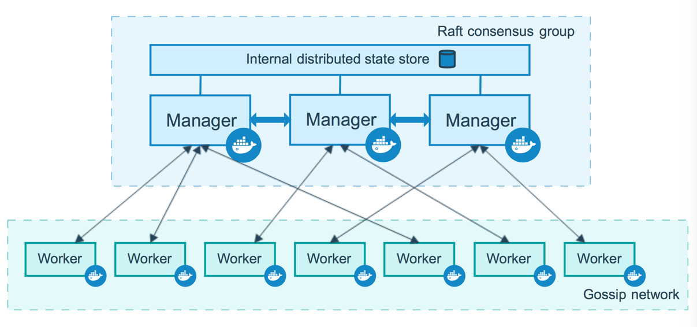
The Big Picture*
* https://docs.docker.com/engine/swarm/how-swarm-mode-works/nodes/

Slide 49
Three Simple Actions
Initialize cluster
docker swarm init
Join to a cluster
docker swarm join
Leave a cluster
docker swarm leave

Slide 50
Deployment Options
Options
Cloud (Azure, AWS, …)
On-premise - VM, Bare-metal
Deployment Strategy (on-premise)
(Semi) Manual
Automated
Today’s practice
Additional practice – homework ☺

Slide 51
Dev
Ops
Stacks and Compose
Deployment Automation

Slide 52
Tasks, Services, and Stacks
Tasks are units of work distributed to nodes
Service is an application deployed on swarm
In fact, service is the definition of the tasks to execute
Replicated and global services distribution model
Stacks are groups of interrelated services
Stacks are deployed with docker-compose
Stack
Service 1
Service 2
Task 1-1
Task1-2
Task 2-1

Slide 53
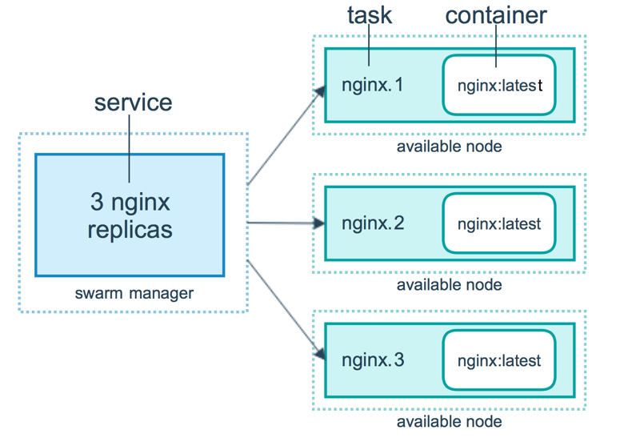
Containers, Tasks, and Services*
* https://docs.docker.com/engine/swarm/how-swarm-mode-works/services/

Slide 54
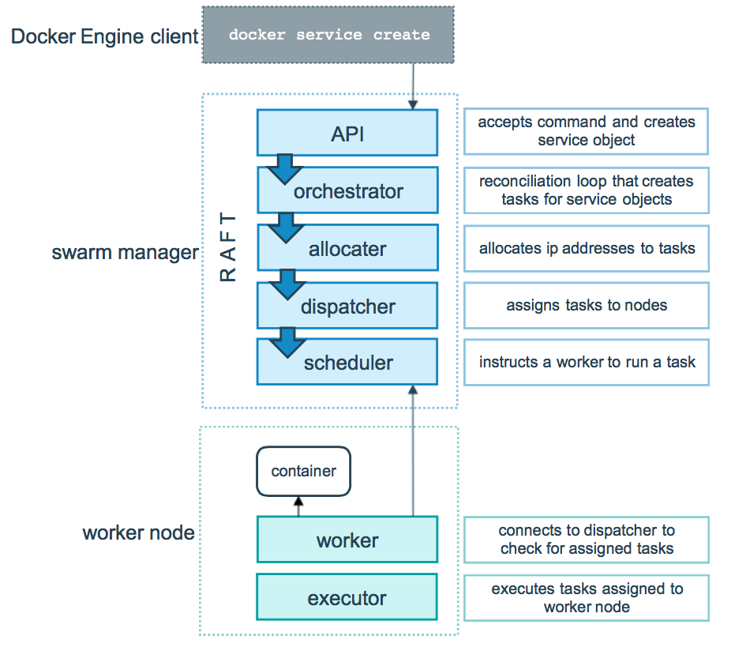
Tasks and Scheduling*
* https://docs.docker.com/engine/swarm/how-swarm-mode-works/services/

Slide 55
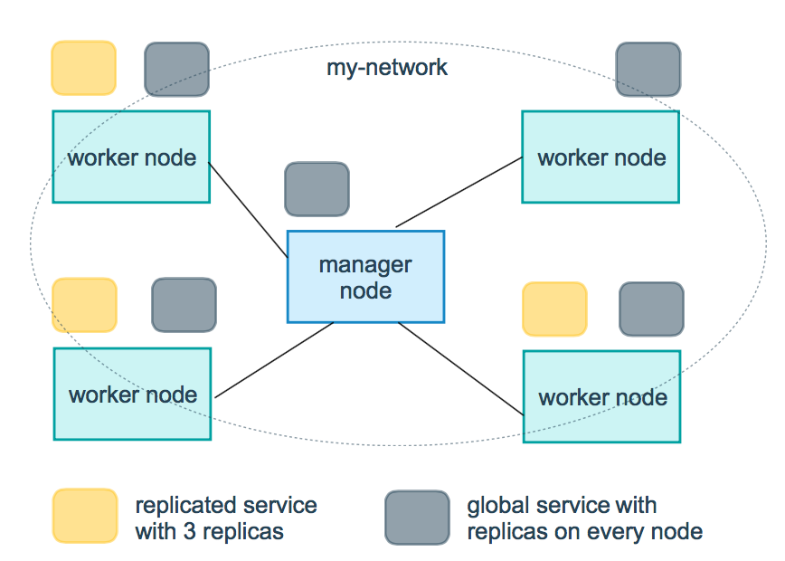
Replicated and Global Services*
* https://docs.docker.com/engine/swarm/how-swarm-mode-works/services/

Slide 56
Dev
Ops
Sharing Data
Configuration and sensitive data

Slide 57
Share Data
Parts of a service can be scheduled on different nodes
They may be driven by external information
We can store the data on every node and mount it from there
While this is working, it is not the best solution
Especially for configuration data and sensitive information
For these we can use one of the two special object types
Configs
Secrets

Slide 58
Docker Configs
Configs are available only in Swarm mode
Can be generic strings or binary data (up to 500 KB in size)
Mounted directly in the container’s filesystem
Can be added or removed at any time
Multiple services can share a config
Managed via separate set of commands
Where ACTION is either create, inspect, ls or rm
Not encrypted
docker config ACTION [options]
https://docs.docker.com/engine/swarm/configs/

Slide 59
Docker Secrets
Secrets are available only in Swarm mode
Can be usernames, passwords, SSH keys, certificates, generic strings or binary data (up to 500 KB in size)
Mounted via RAM disk to the containers
Access to secrets and be added or removed at any time
Services can share a secret
Managed via separate set of commands
Where ACTION is either create, inspect, ls or rm
Encrypted
docker secret ACTION [options]
https://docs.docker.com/engine/swarm/secrets/

Slide 60
Dev
Ops
Practice: Swarm, Services and Stacks
Live Demonstration in Class

Slide 61

Summary
Networking - inspect, tune, add, and remove
Volumes - types, inspect and manage
Distributed applications and Docker Compose
Docker Swarm
How it works
Deployment options
Stacks and Compose
…
…
…

Slide 62
Questions?
Notes:
62

Slide 63














SoftUni Diamond Partners

Slide 64

Educational Partners

Slide 65

License
This course (slides, examples, demos, exercises, homework, documents, videos and other assets) is copyrighted content
Unauthorized copy, reproduction or use is illegal
© SoftUni – https://softuni.org
© Software University – https://softuni.bg
Notes:
65

Slide 66
Trainings @ Software University (SoftUni)
Software University – High-Quality Education, Profession and Job for Software Developers
softuni.bg, softuni.org
Software University Foundation
softuni.foundation
Software University @ Facebook
facebook.com/SoftwareUniversity
Software University Forums
forum.softuni.bg
Notes:
66

